Slide 1
Chapter 1

Slide 2
Most Important
The tao that can be told is not the eternal Tao. The name that can be named is not the eternal Name.
The unnamable is the eternally real. Naming is the origin of all particular things.

Slide 3
Building Blocks
Hardware
Data
Programs
Operating system
But
Programs are data and operating systems are programs
So, hardware and data

Slide 4
Life is Computing
How many computers did you use today?
Phones, cars, trains, airplanes, TV, displays
Banks, schools
Email, social media
Probably at least a hundred
DNA computes
You compute
Shouldn’t you know more about such a pervasive technology?

Slide 5
Programs
Algorithms
Vernacular
Really: recipes for computers
A sequence of operations to perform a task
Versus code

Slide 6
Data
What an algorithm operates on
Numbers, characters, media
Binary representation (lots more on this later)
Programs are data also
John Von Neumann
Manhattan project, IAS, quantum logic, game theory,
Etc., etc.

Slide 7
Processing
Programs working on data
Well, data working on data
Applications

Slide 8

Top Secret Rosies: The Female Computers of WWII
Notes:
http://www.amazon.com/Top-Secret-Rosies-Female-Computers/dp/B00N6IV2SC

Slide 9
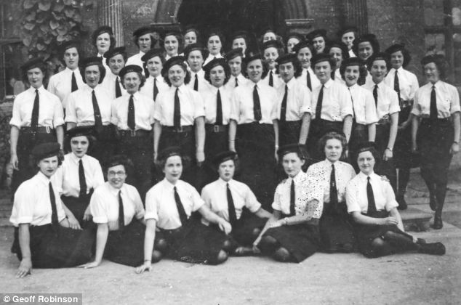
First Computors
Notes:
http://www.dailymail.co.uk/news/article-2551486/Pictured-time-The-women-code-breakers-operated-worlds-electronic-computer-Second-World-War.html

Slide 10
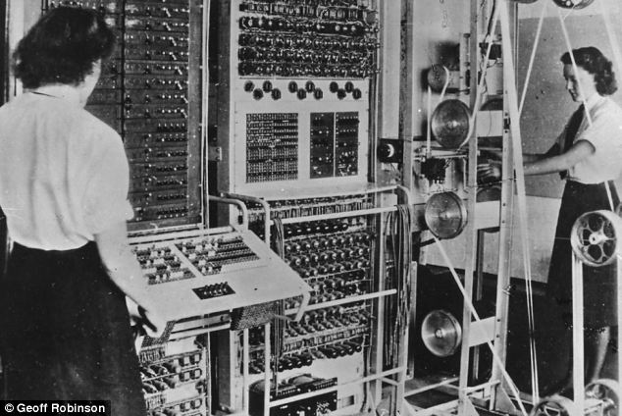
First Computer Operators

Slide 11
Computer Basics
Gates
AND, OR, XOR, NOT, connections
Similar to neurons

Slide 12
Binary Logical Operations
A AND B | A | !A
B | 1 | 0
!B | 0 | 0
A OR B | A | !A
B | 1 | 1
!B | 1 | 0
A XOR B | A | !A
B | 0 | 1
!B | 1 | 0
NOT A
A | 0
!A | 1

Slide 13
(Half) Addition
A + B | A | !A (A=0)
B | 2 (10) | 1
!B (B=0) | 1 | 0

Slide 14
Addition
A + B + C | A=0,B=0 | A=1,B=0 | A=1,B=1 | A=1,B=0
C=0 | 0 | 1 | 0, C | 1
C=1 | 1 | 0 | 1, C | 0, C

Slide 15
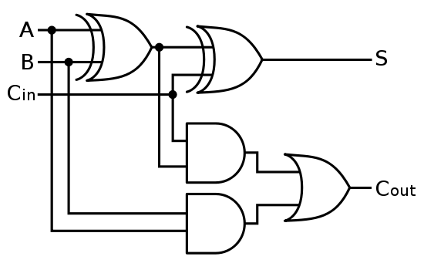
Circuit
Sum = A XOR B XOR C
Carry = (A AND B) OR (C AND (A XOR B)

Slide 16
Parts
Central processing unit (CPU)
Main memory (DRAM)
Input/output (I/O)
Keyboards, monitors, disks, etc.

Slide 17
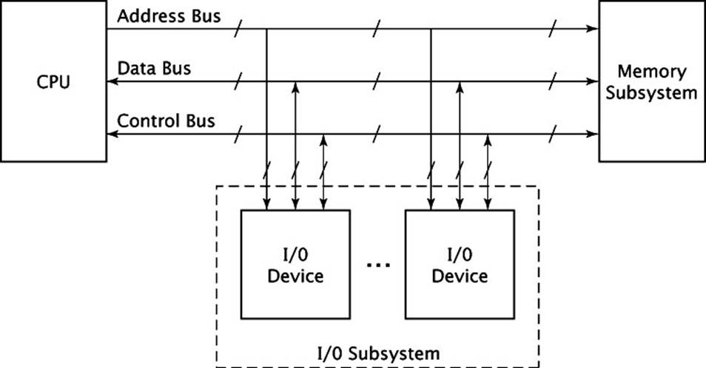
Organization

Slide 18
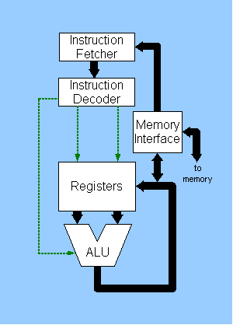
CPU
Notes:
http://www.lions-wing.net/lessons/hardware/hard.html

Slide 19
CPU
The “brains”
Fetches instructions and input
Operates on them
Produces output
Has an Arithmetic and Logic Unit (ALU)
Stores temporary results in registers (very fast memory)

Slide 20
Busses
CPU, memory, and I/O need to communicate
A bus is a collection of wires
Sometime on printed circuit board (PCB)
Sometimes external such as universal serial bus (USB) cables
Contains control and data lines
Control allows different components access
Combination of low (e.g. USB) and high (e.g. memory) buses

Slide 21
Slots
PCs have expansion slots to add more cards for more functionality
Peripheral component interconnect (PCI) and its variants typical today

Slide 22
Speed Limits
Pesky speed of light
Buses are one at a time
CPU faster than memory faster than peripherals faster than humans

Slide 23
Latency
How long an operation takes to complete
Speeding up individual components helps
Smaller is typically faster
Integrate as much as possible
Keep data close to processor
But system must be balanced

Slide 24
Seven Approaches
New faster technology
Keep data close to processor
Cache
Many layers
Optimize CPU
Integrate more functionality on one chip
Multiple buses – “channels”
Alternatives (e.g.: GPU processing)

Slide 25
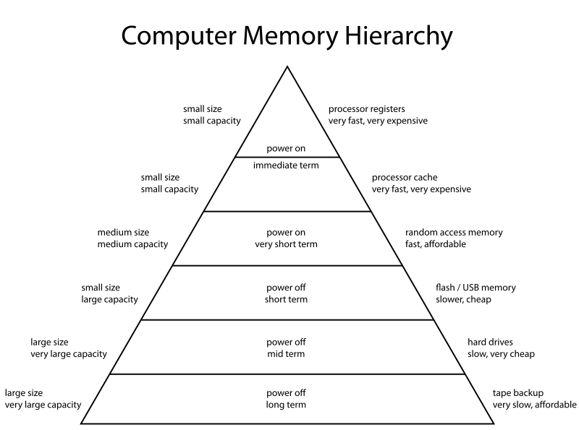
Memory Hierarchy
Notes:
https://en.wikipedia.org/wiki/Memory_hierarchy

Slide 26
Buses
Or sometimes busses
Wider
Faster
Specialized
Graphics

Slide 27
Alternative
Multiple CPUs
If on one chip: cores
Specialized processors
I/O
Interrupt driven
GPU
Direct Memory Access (DMA)

Slide 28
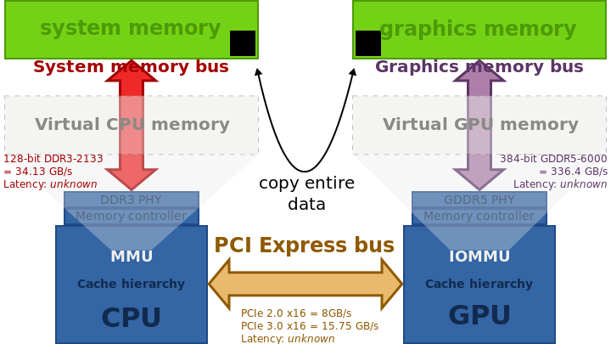
Classic PCIe Graphics
Notes:
https://en.wikipedia.org/wiki/Video_card

Slide 29
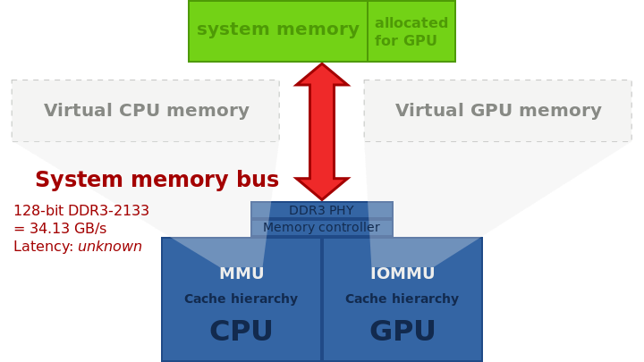
Integrated with Partitioned Memory

Slide 30
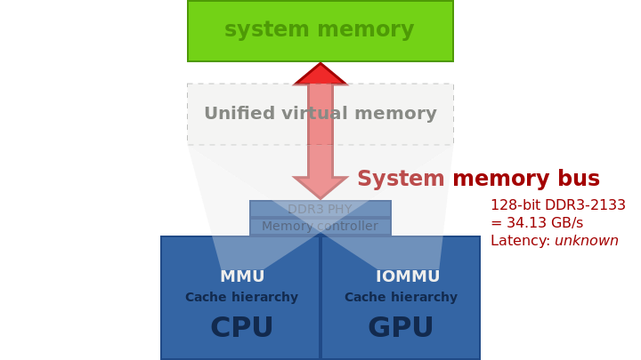
Integrated with Unified Memory

Slide 31
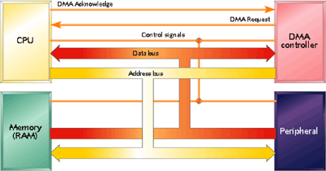
Direct Memory Access
Notes:
http://www.embedded.com/electronics-blogs/beginner-s-corner/4024879/Introduction-to-direct-memory-access

Slide 32
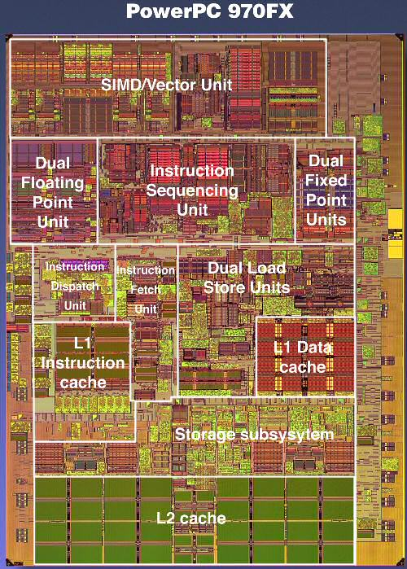
Die Shot of Single CPU
Notes:
http://www.anandtech.com/show/1702/2

Slide 33
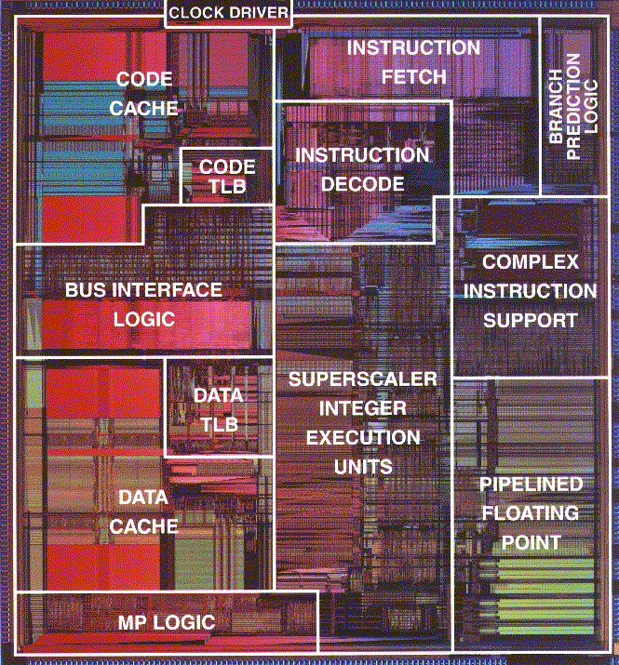
Pentium
Notes:
http://people.cs.clemson.edu/~mark/330/p6.html

Slide 34
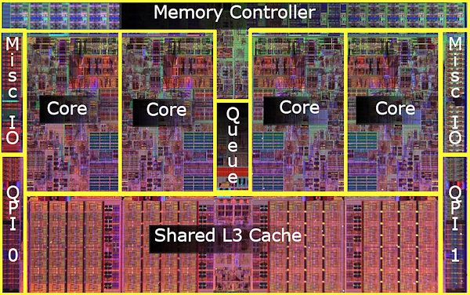
i7
Notes:
http://techreport.com/review/15818/intel-core-i7-processors

Slide 35
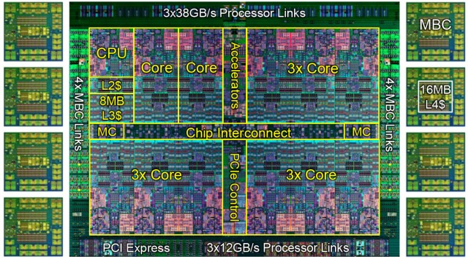
Power 8
Notes:
http://www.extremetech.com/computing/181102-ibm-power8-openpower-x86-server-monopoly

Slide 36
Pentium vs. i7
Name | Pentium | I7
Years | 1993 – 1999 | 2011 – present
Clock speed | 60 – 200 MHz | 3 – 4 GHz
Pins | 321 | 1366
Feature size | 800 – 350 nm | 32 – 22 nm
Transistors | 3M | 731M
Power | 8 – 15.5 W | 130 – 150 W
Cores | 1 | 4 – 16
Bus speed | 50 – 66 Mhz | 2.5 – 6.4 GT/s
L1 cache | 16KB | 64KB per core
L2 cache | NA | 6x256 KB
L3 cache | NA | 12 – 20 MB

Slide 37
Physical Limitations
Chip size
Larger allow more functionality, but has more defects per chip
Width of transistors
Smaller is faster and less power, but quantum effects start
Clock speed
Faster is better, but not always directly related to computing power

Slide 38
Physical Limitations
Power
Usually the limiting figure
150W from something smaller than a postage stamp
Power = heat
1W in = 1W out
Heat sinks, fans, liquid cooling

Slide 39
Another Approach
ARM processors
Reduced Instruction Set Computer (RISC)
Vs. traditional Complex Instruction Set Computer (CISC)
Lower power
Phones, laptops, tablets

Slide 40
Mother
Motherboards hold CPU, I/O, graphics, memory chips, expansion slots
Called a Printed Circuit Board (PCB)
Made of many (2 – 12) layers

Slide 41
Small
Notes:
https://en.wikipedia.org/wiki/Order_of_magnitude

Slide 42
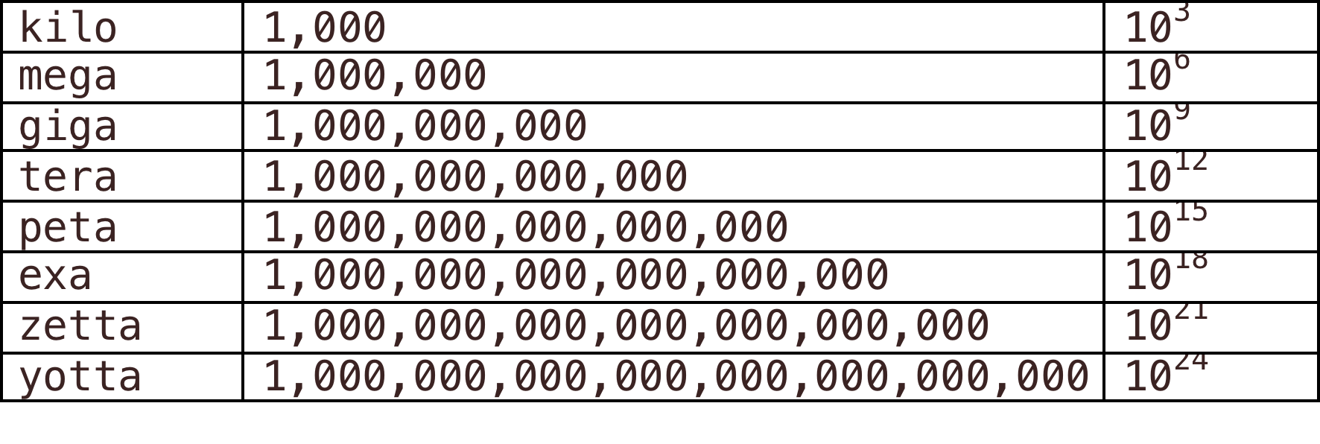
Large

Slide 43
Measurements
Millions of Instruction per Second (MIPS)
Floating Point Operation per Second (FLOPS)
Bandwidth: Megabits per second, Gigabits per second

Slide 44
Transistor
Amplifies or switches signals
Switch similar to light switch
Semiconductor
Conducts or not depending on inputs
Nobel to John Bardeen, Walter Brattain, and William Shockley
Silicon, germanium, gallium arsenide

Slide 45
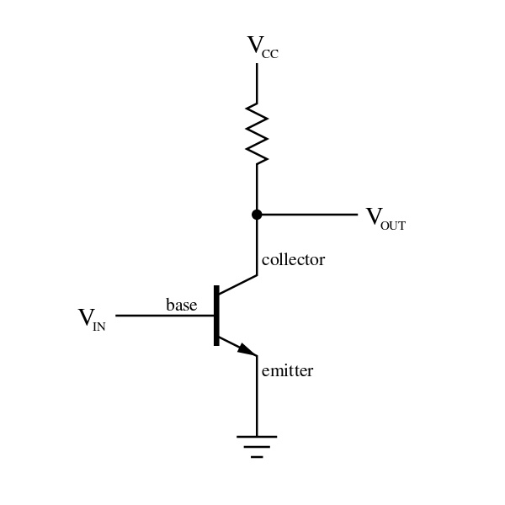
Transistor
Notes:
https://en.wikipedia.org/wiki/Transistor

Slide 46
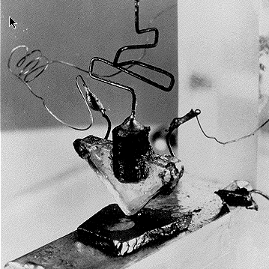
First Transistor
Notes:
https://prezi.com/jsucvixpkdom/the-invention-of-the-transistor/

Slide 47
Chips
Are built on silicon wafers
Made of many layers
First layer contains the transistors
Subsequent layers connect the transistors

Slide 48
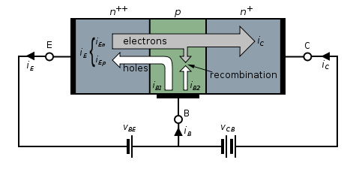
NPN Transistor

Slide 49
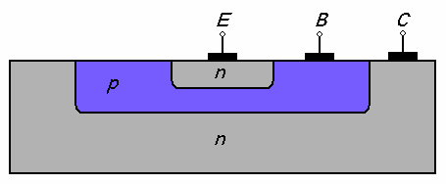
Planar NPN

Slide 50
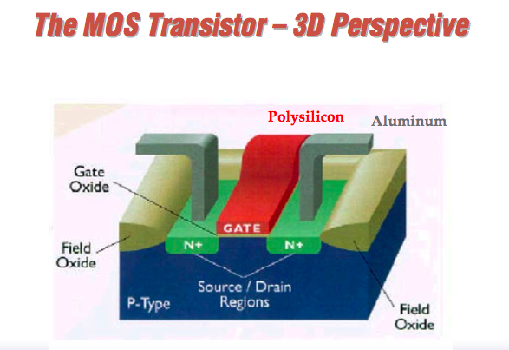

Slide 51
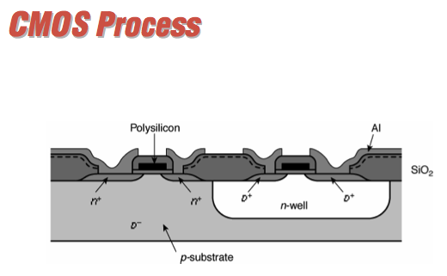

Slide 52
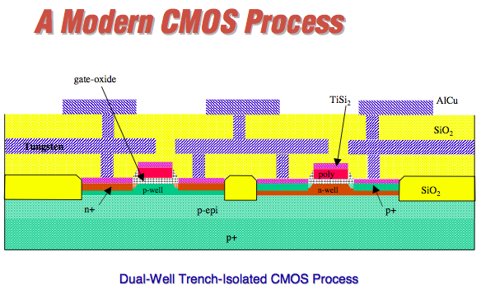

Slide 53
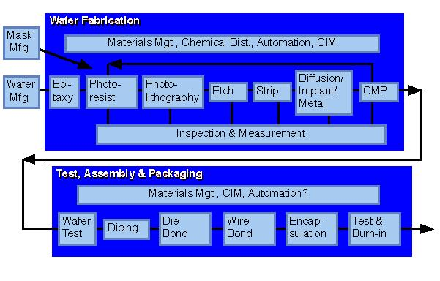
Semiconductor Manufacturing Process

Slide 54
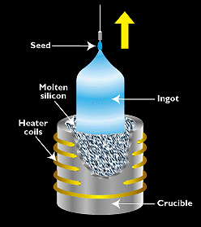
Czochralski

Slide 55
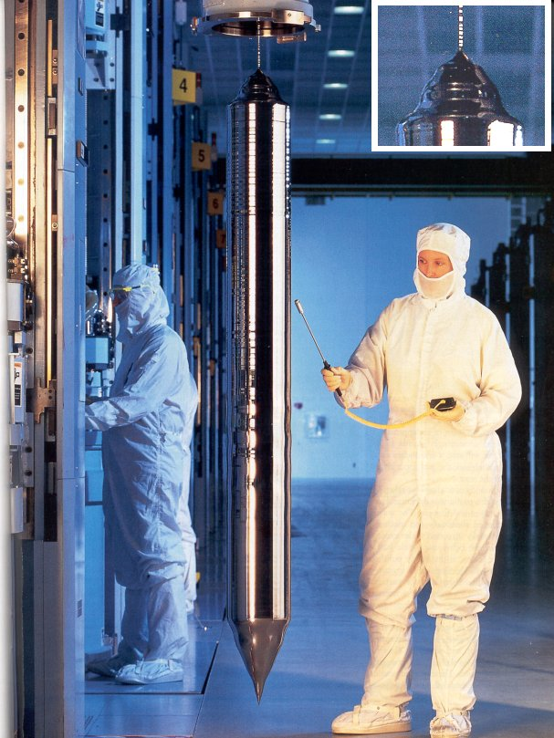

Slide 56
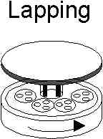
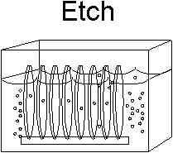
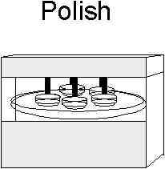
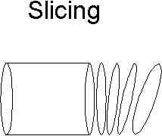
Wafer Finishing

Slide 57
Photolithography
Photolithography is a technique that is used to define the shape of micro-machined structures on a wafer

Slide 58
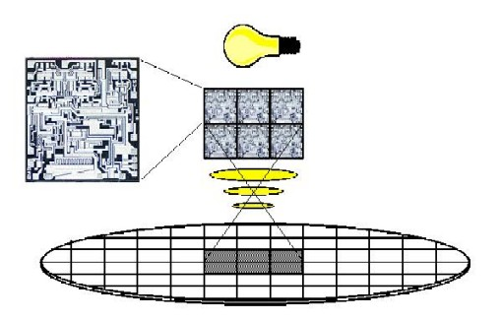

Slide 59
Photolithography Photoresist
The first step in the photolithography process is to develop a mask, which will be typically be a chromium pattern on a glass plate
Next, the wafer is then coated with a polymer which is sensitive to ultraviolet light called a photoresist
Afterward, the photoresist is then developed which transfers the pattern on the mask to the photoresist layer

Slide 60
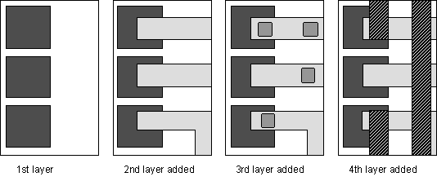

Slide 61
Photolithography Photomasks and Reticles
A square glass plate with a patterned emulsion of metal film on one side
The mask is aligned with the wafer, so that the pattern can be transferred onto the wafer surface
Each mask after the first one must be aligned to the previous pattern.

Slide 62
Photolithography Photomasks and Reticles
When a image on the photomask is projected several time side by side onto the wafer, this is known as stepping and the photomask is called a reticle.
An common reticle is the 5X
The patterns on the 5X reticle are reduced 5 times when projected onto the wafer

Slide 63
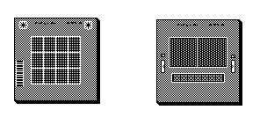
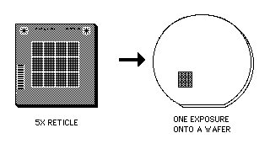
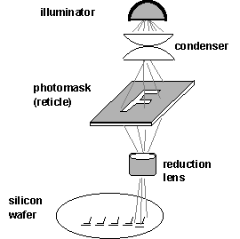
Photolithography Photomasks and Reticles
Examples of 5X Reticles:

Slide 64
Oxidation
SiO2 growth is a key process step in manufacturing all Si devices
Thick (~1µm) oxides are used for field oxide (isolate devices from one another )
Thin gate oxides (~100 Å) control MOS devices
The stability and ease of formation of SiO2 was one of the reasons that Si replaced Ge as the semiconductor of choice.

Slide 65
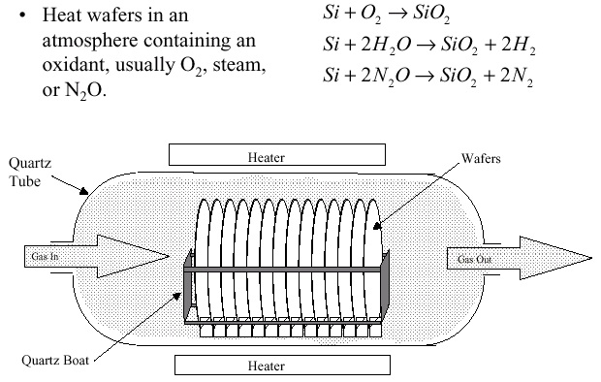
The simplest method of producing an oxide layer consists of heating a silicon wafer in an oxidizing atmosphere.

Slide 66
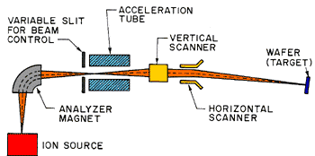
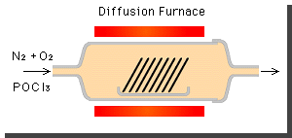
Diffusion Process Ion Implantation

Slide 67
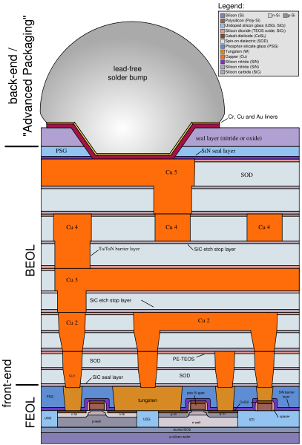

Slide 68
Test and Package
Wafer test
Dicing
Packaging
Bonding
Chip test
Typical wafer fab cycle time 6 to 8 weeks

Slide 69
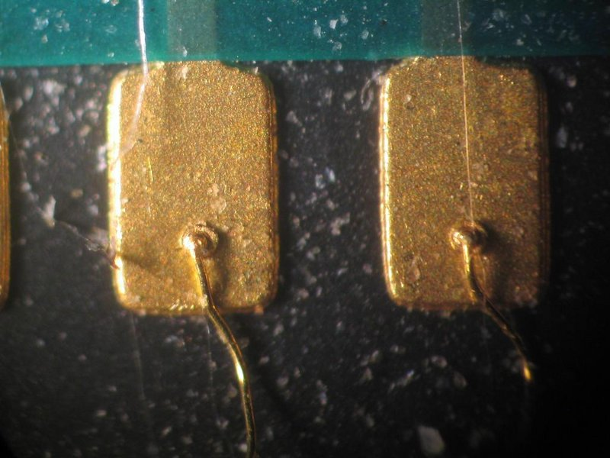

Slide 70
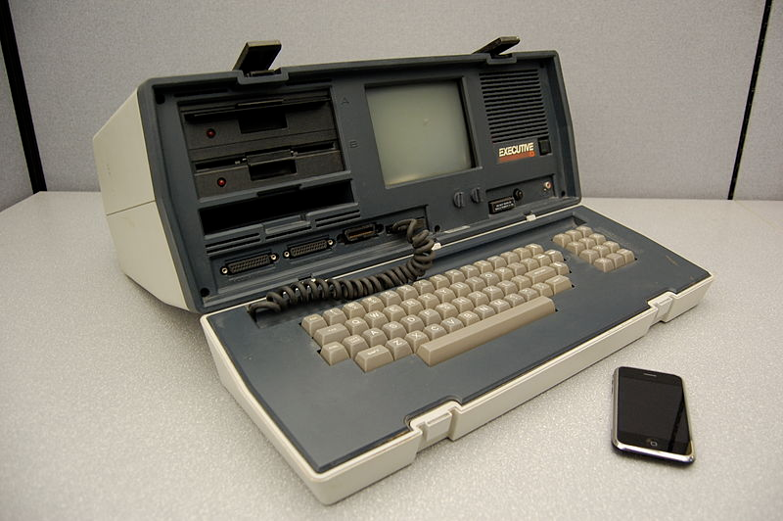
1982 vs. 2007

Slide 71
1982 vs. 2007
An Osborne Executive portable computer, from 1982 with a Zilog Z80 4MHz CPU, and a 2007 Apple iPhone with a 412MHz ARM11 CPU; the Executive weighs 100 times as much, has nearly 500 times as much volume, cost approximately 10 times as much (adjusted for inflation), and has about 1/100th the clock frequency of the smartphone.

Slide 72
Moore’s Law
Gordon Moore
Co-founder of Intel
Chip density doubles every two years
Does not state that performance will also double
Performance based on multiple factors
Notes:
https://en.wikipedia.org/wiki/Moore's_law

Slide 73
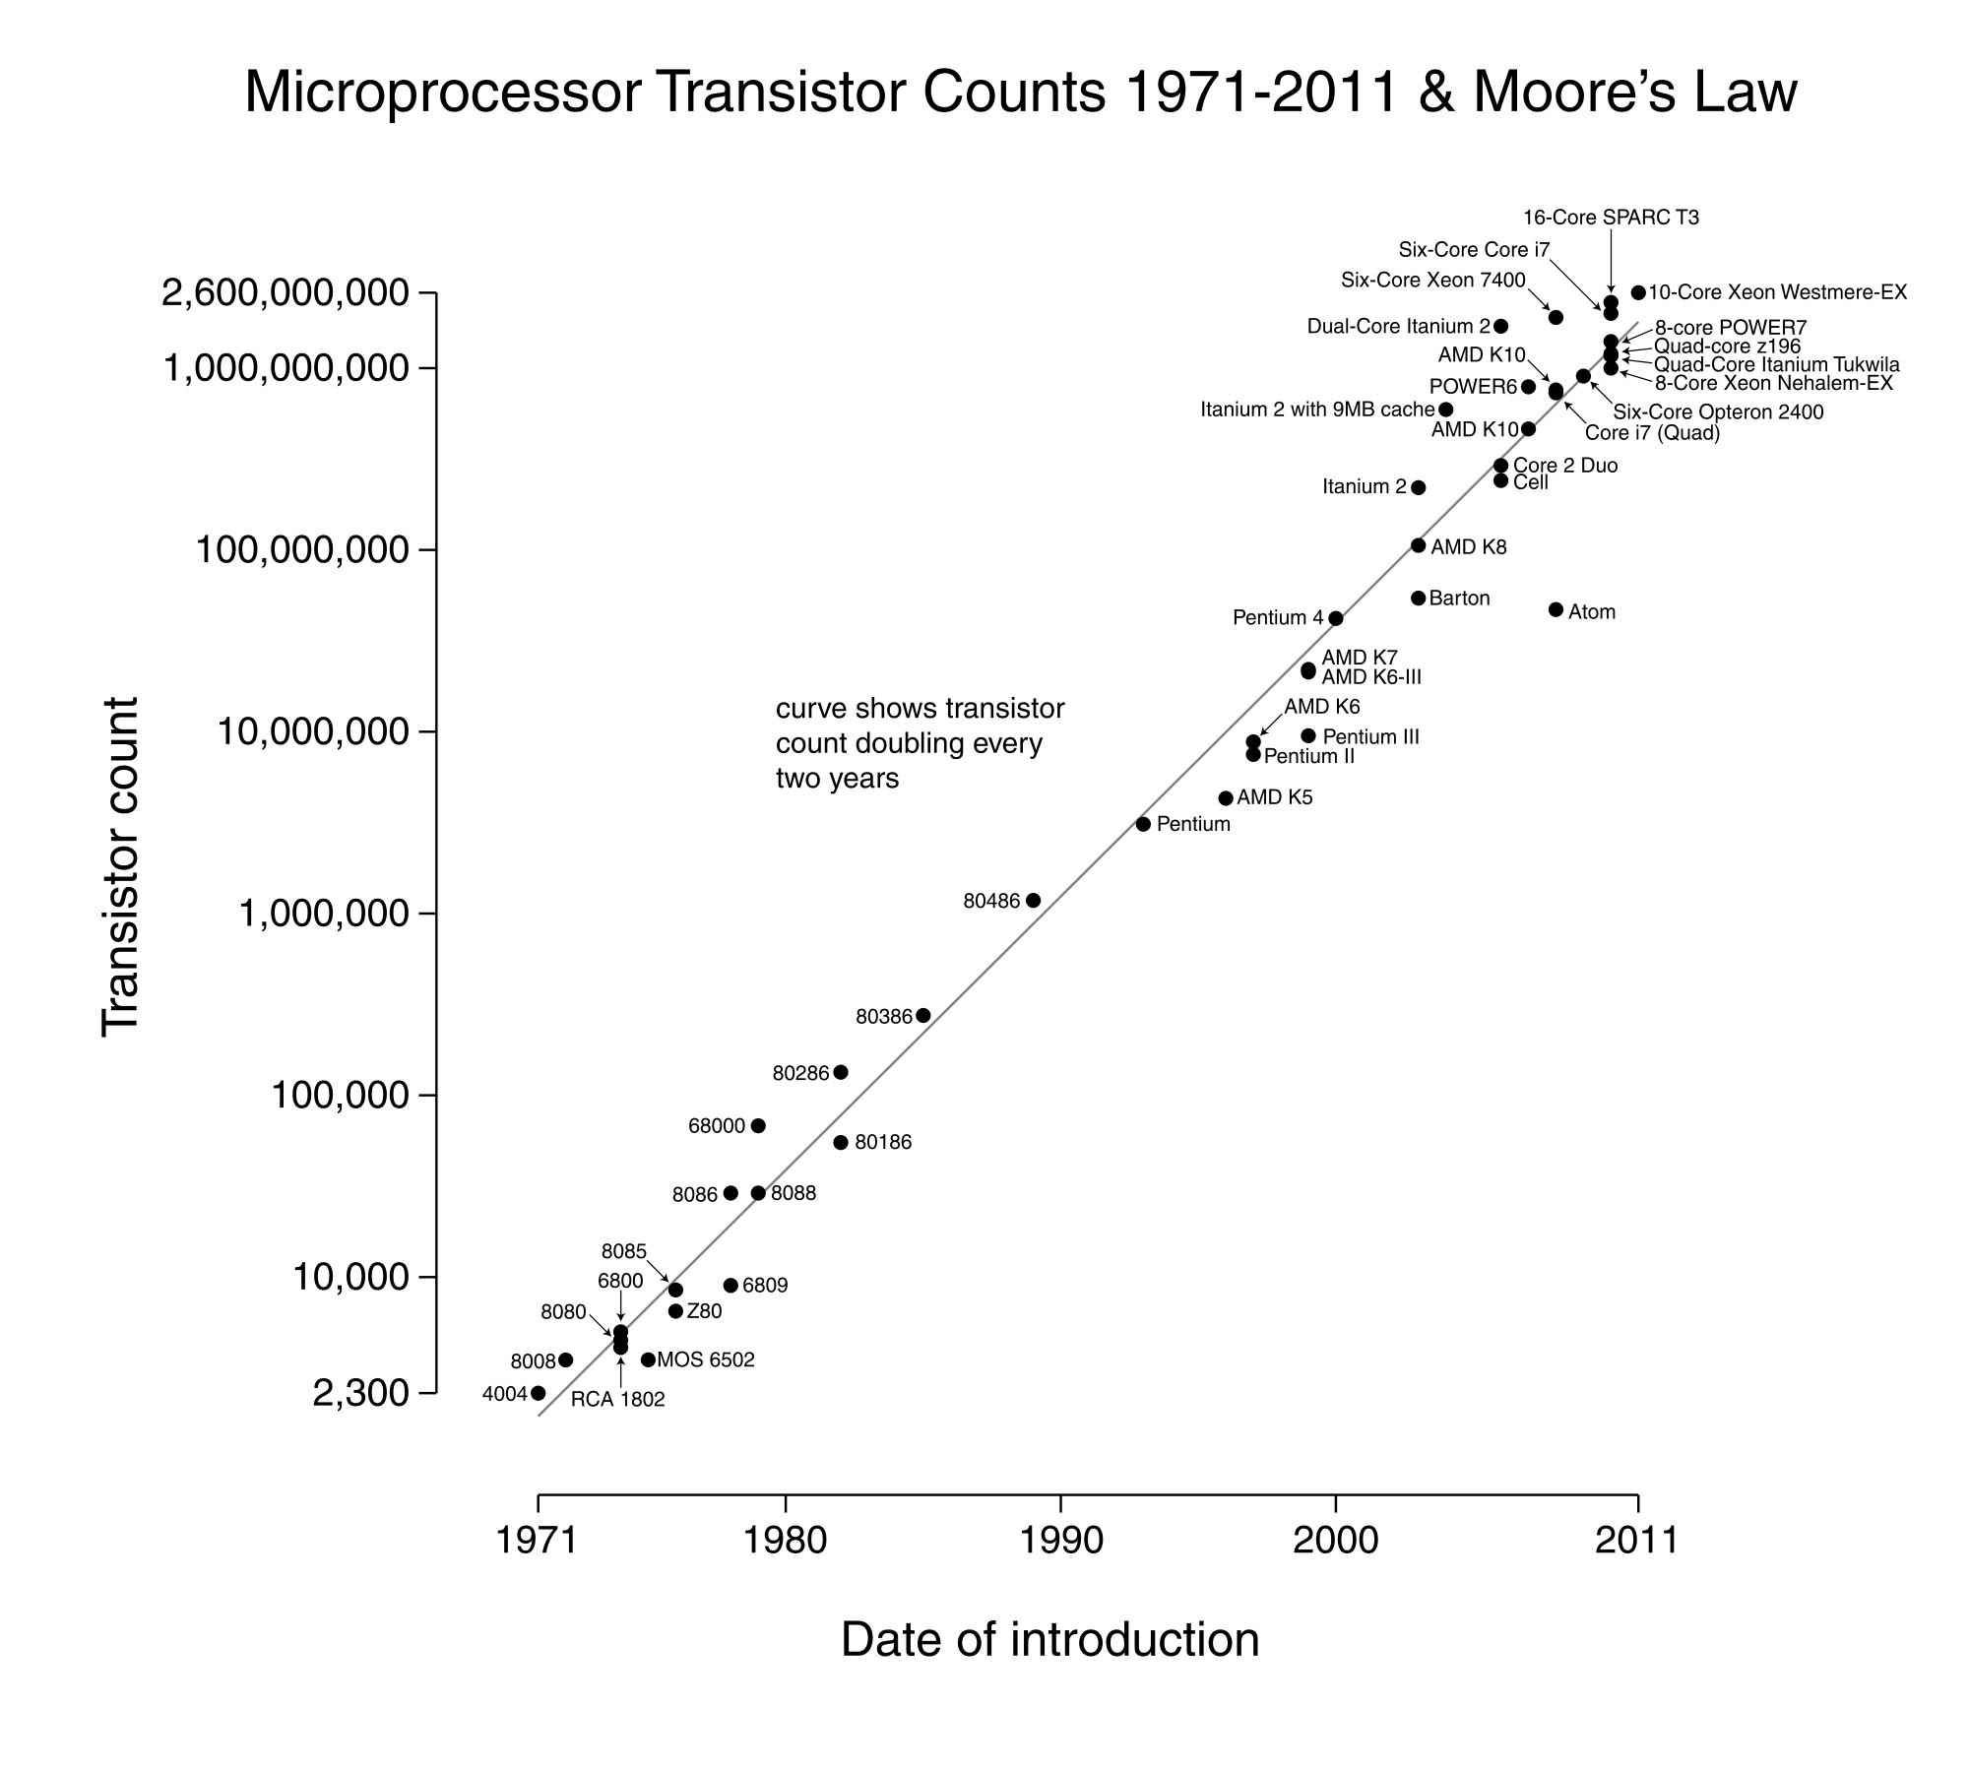
Moore’s Law
Notes:
http://www.aspistrategist.org.au/wp-content/uploads/2013/04/Transistor_Count_and_Moores_Law_-_2011.svg-copy.jpg

Slide 74
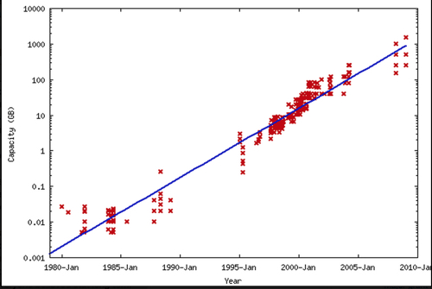
Kryder’s Disk Space Law
Notes:
http://regmedia.co.uk/2014/11/10/disk_capacity_increase.jpg

Slide 75
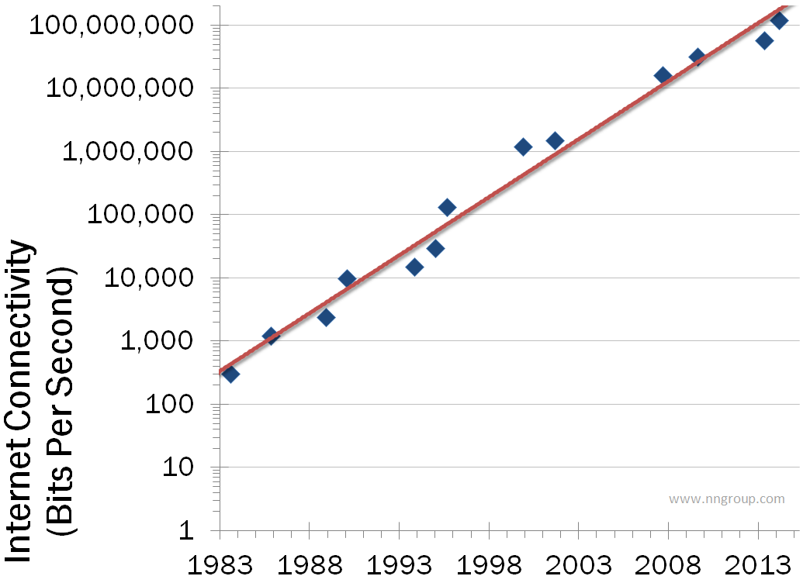
Nielsen's Law of Network Bandwidth
Notes:
http://s3.amazonaws.com/media.nngroup.com/media/editor/2014/08/08/internet-bandwidth-nielsens-law-1983-2914.png

Slide 76
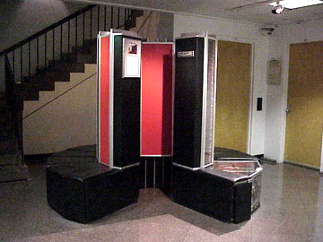
Cray 1 at NCAR

Slide 77
Cray 1
5.5 tons including the Freon refrigeration system. Configured with 1 million words of main memory, the machine and its power supplies consumed about 115 kW of power
250 MFLOPS

Slide 78
Yellowstone at NCAR
1.5 petaflops
4,536 CPUs
72,576 Cores
144.6 TB memory

Slide 79
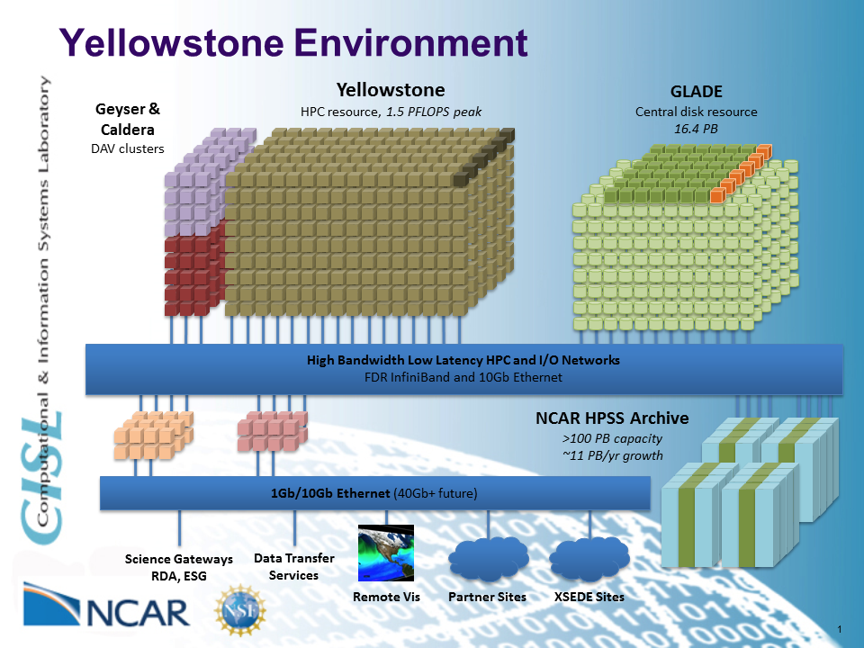
Yellowstone at NCAR

Slide 80
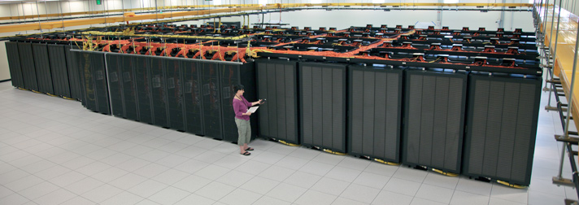
Yellowstone at NCAR

Slide 81
Knights Landing
72 core with 4 threads per core
160 – 215W
14nm
8B transistors
~1 TFLOP

Slide 82
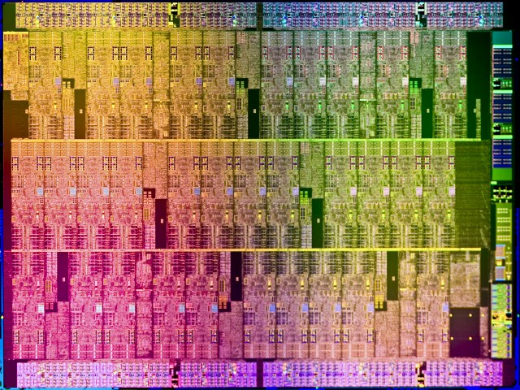
Knights Landing
Notes:
6 teraflops, 8B transistors, 60 cores, 240 threads, 16GB near memorym 6 4DDR slot (384G memory), 2 PCIe connections

Slide 83
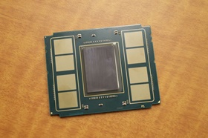
Knights Landing Packaging

Slide 84
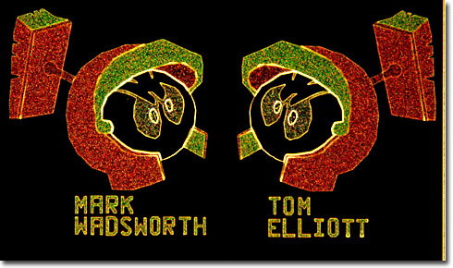
Appearing as an opposed duet of helmeted gladiators, these angry silicon soldiers were discovered on the surface of an image sensor used by the Spirit and Opportunity rovers sent to probe the Red planet.
Notes:
http://micro.magnet.fsu.edu/creatures/index.html

Slide 85
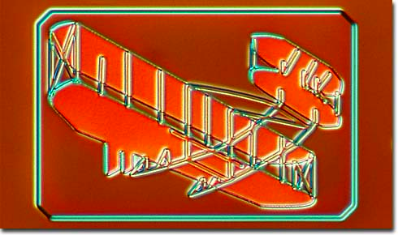

Slide 86


Slide 87


Slide 88


Slide 89


